Slide 2



Introduction to Azure Bot Services
Richard Fisher, Solutions Architect (Pramerica)
@
/in/

Slide 3
Agenda
Digital Transformation
What are Bots?
Building Bots
Bot Creator Personas
Bot Demos
Trading Bot – Azure Logic Apps
HR Bot – Microsoft Flow
Access Management Bot – Microsoft Flow

Slide 4
Digital Transformation
“Digital Transformation is the methodology in which organizations transform, create new business models and culture with digital technologies.”
Ray Wang, Constellation Research

Slide 5
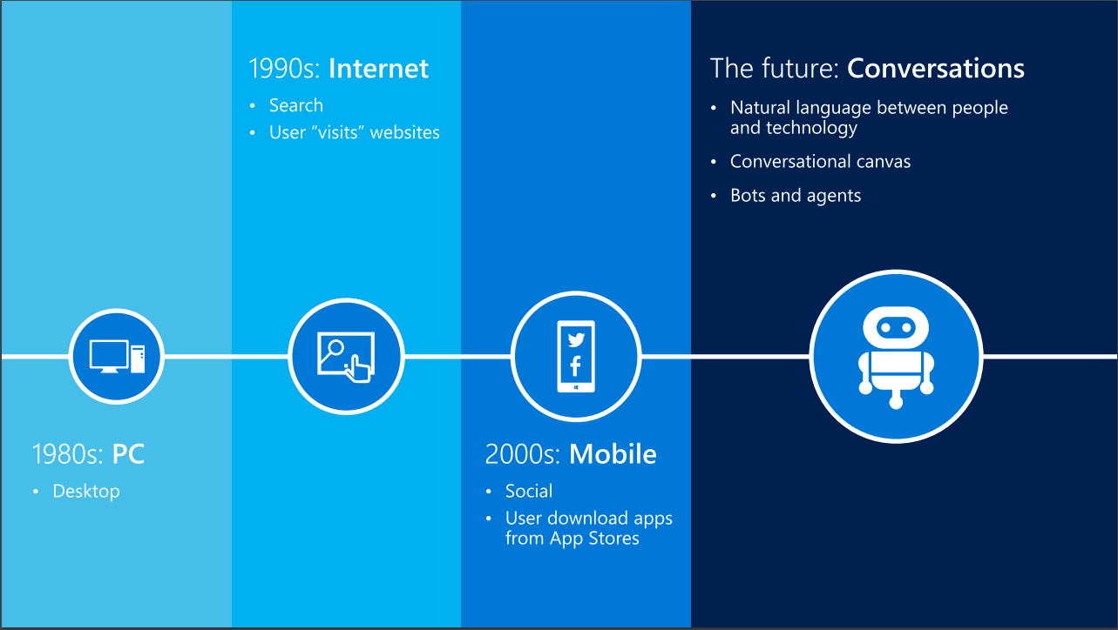

Slide 6


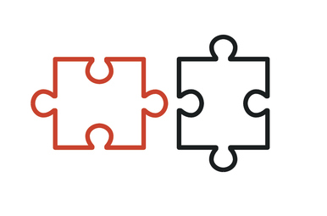



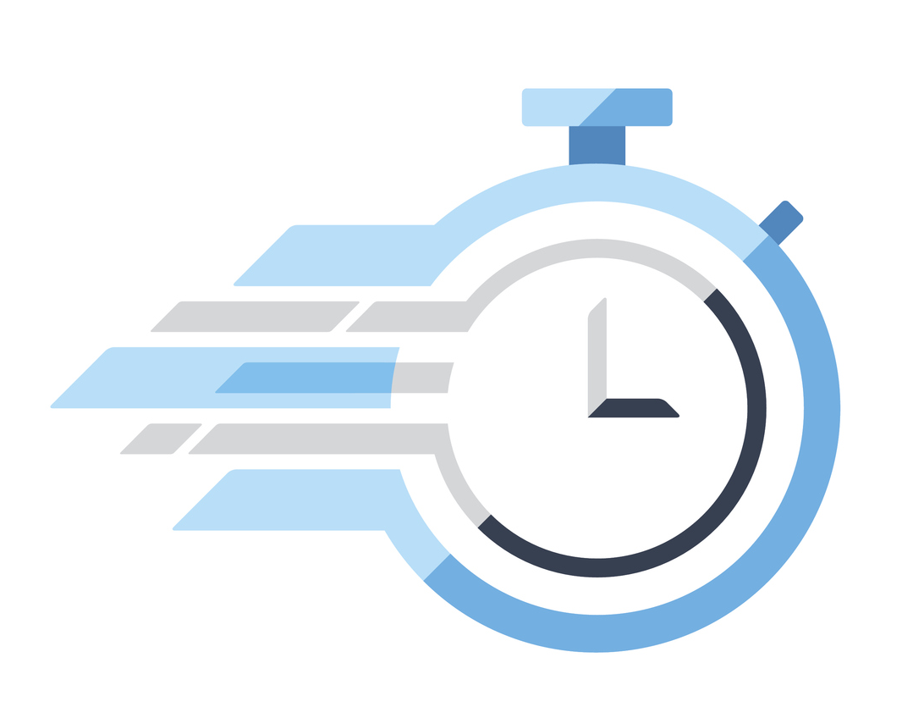
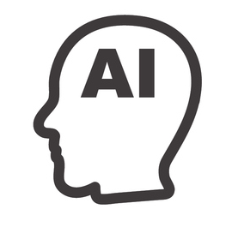
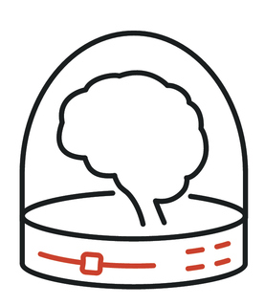



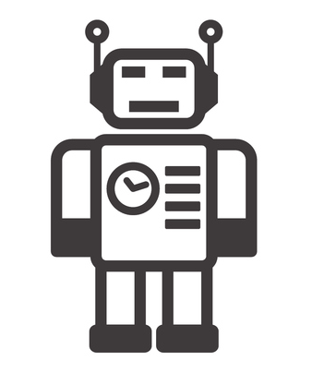



Digital Transformation - IT Enablement
Area of focus
Data Center
Zero Data Centre
Leveraging Platforms
Automating Insight
Fixed Costs
Metered
Artificial Intelligence
Time
Fixed
Infrastructure
Speed
Machine Learning
Elastic
Build for
Peak
Value
Bots
Automation

Slide 7
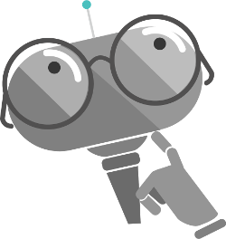
Bots
Reduce barriers and empower users through conversational apps.

Slide 8
Rise of the Cognitive Assistant
Assistants are being embedded everywhere; are increasing ability to solve problems.
As computing advances, so will Virtual Assistant ability to help in task completion.
Virtual Assistants ability to be “smart”, and to understand intent, tone, and context.
Market demand for meaningful, stateful and goal oriented conversations.

Slide 9
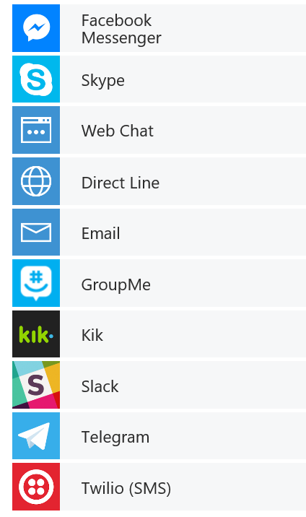


What is a Bot ?
channels
Humans
Your Bot – A web app
Any APIs
MS Bot Connector -
Routes Messages, Manages State, Storage etc.
Cognitive APIs

Slide 10
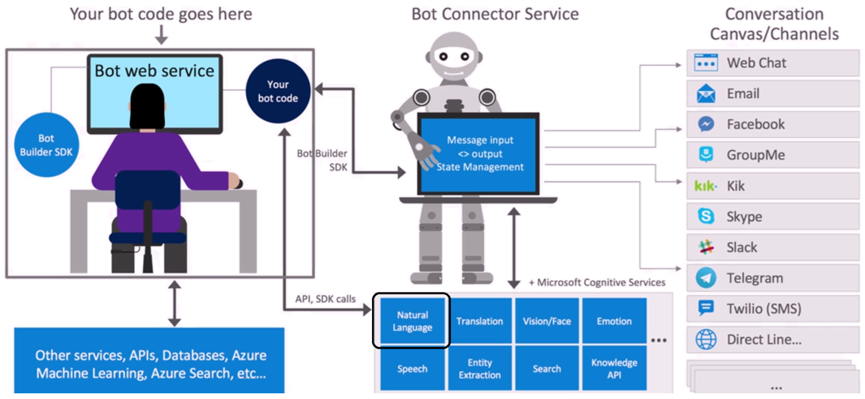

Slide 11
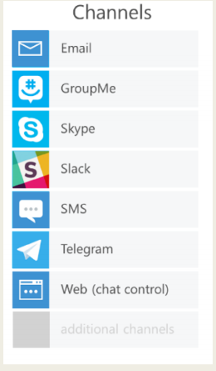

Connectors and Benefits
Connector to Platform Channels
One Bot : Many Channels and endpoints
Why restrict yourself to one platform?
Hit them all
Half the battle is getting users to download your app.
They already have these installed

Slide 12
Bot Framework
Supports NodeJS and C# .NET
Lead users through conversation – Prompts, Choices, Media, Rich Cards (Displays)
Bot Emulator provided for local development/testing
Easy to incorporate Natural Language Processing (Cognitive Services)
Easily deploy to Azure Cloud Services

Slide 13
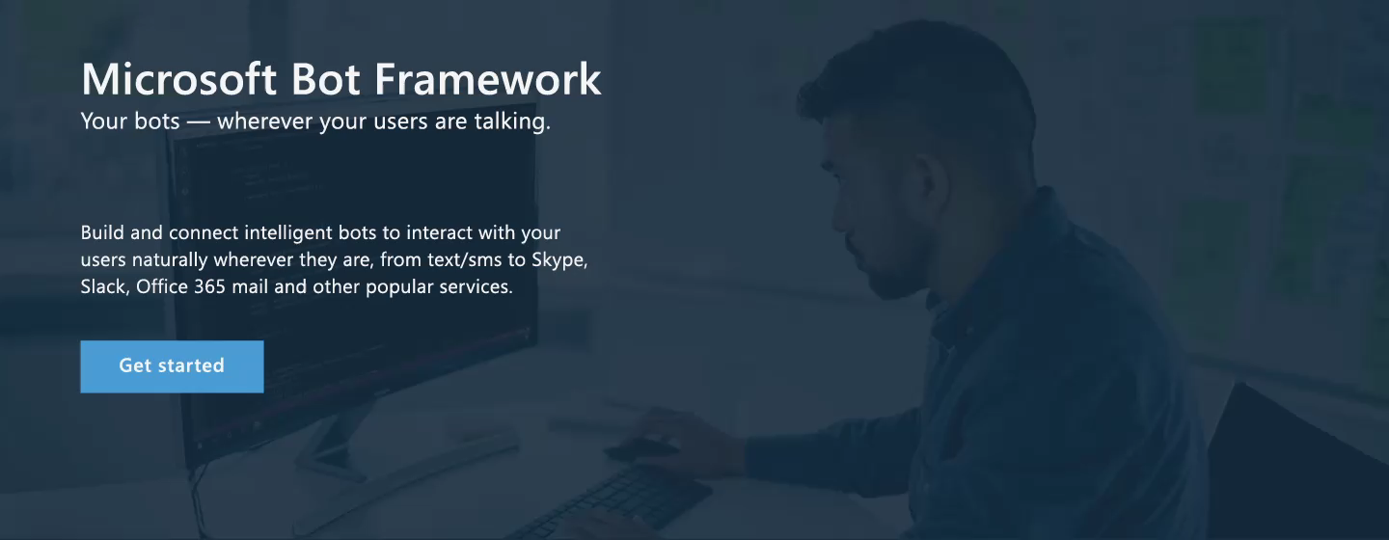
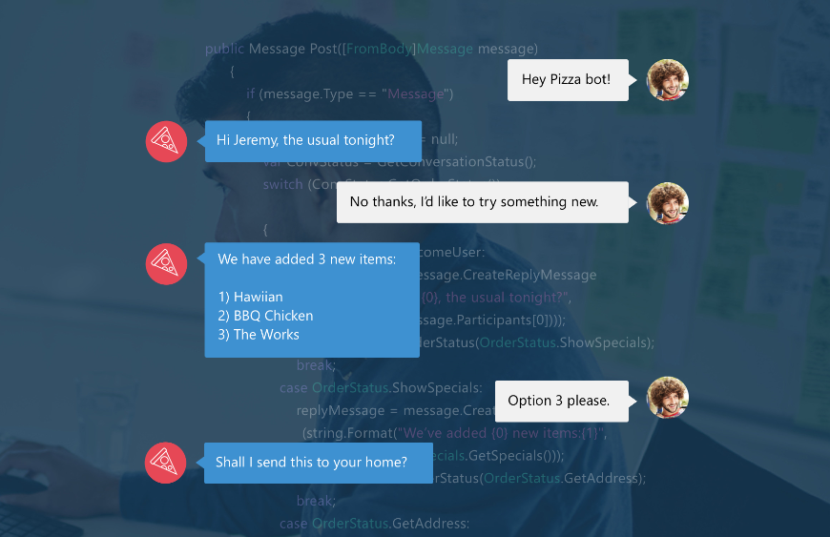
Bot Framework - Engage with your users
A natural language interface across all conversation channels
Insights
Operationalization
Provide information
Perform tasks
Make recommendations
Capture information

Slide 14
LUIS.ai
Language Understanding Intelligence Service (LUIS)
Natural Language Processing (NLP)
Using artificial intelligence to process natural language
Extract Intents (meaning of the utterance)
Extract Entities (items in the utterance that are of value) ■
This is a huge problem developers working with AI or human speech encounter
Cognitive Services: LUIS abstracts this into a training model

Slide 15
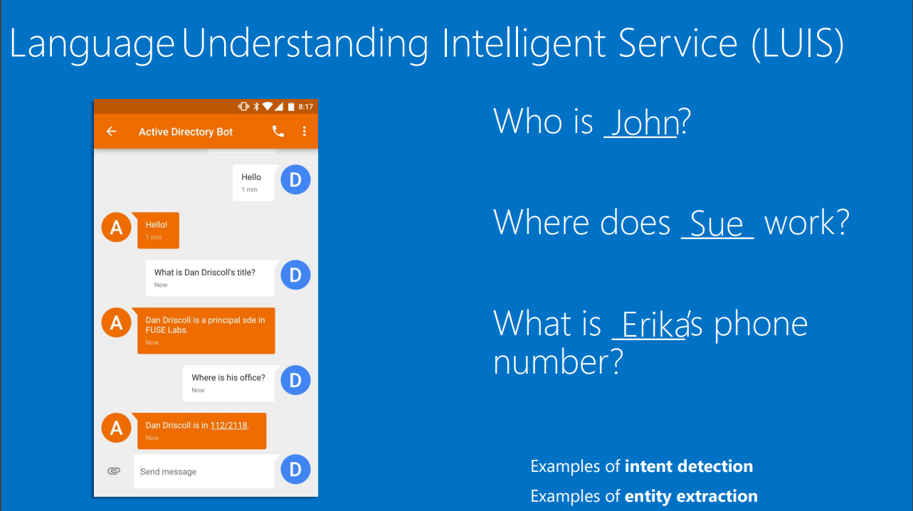

Slide 16
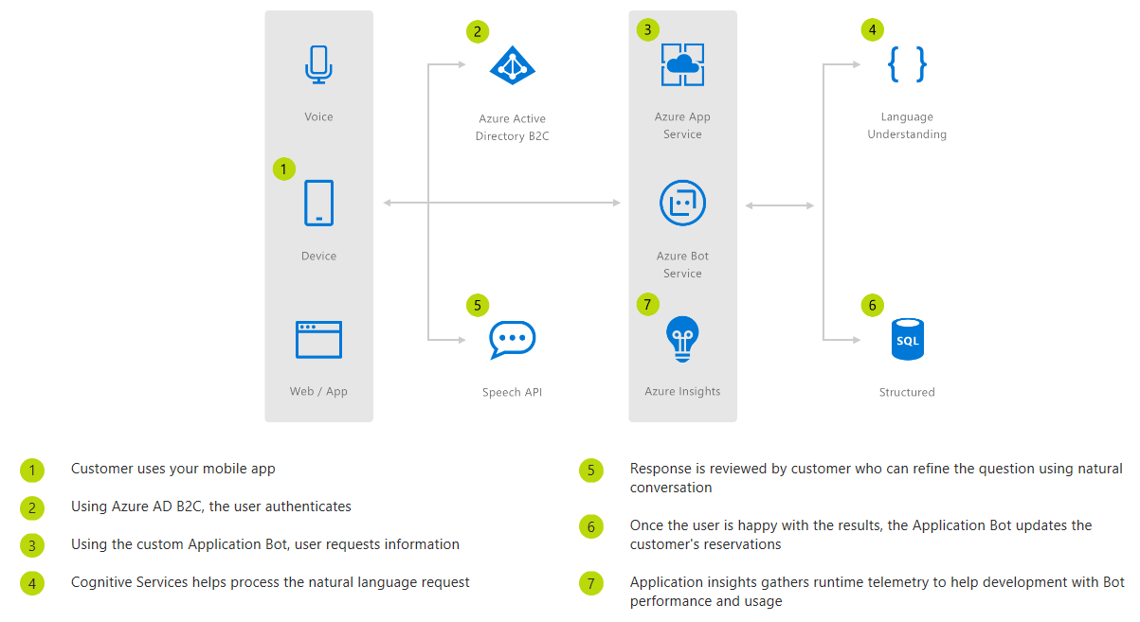
Commerce Chatbot

Slide 17
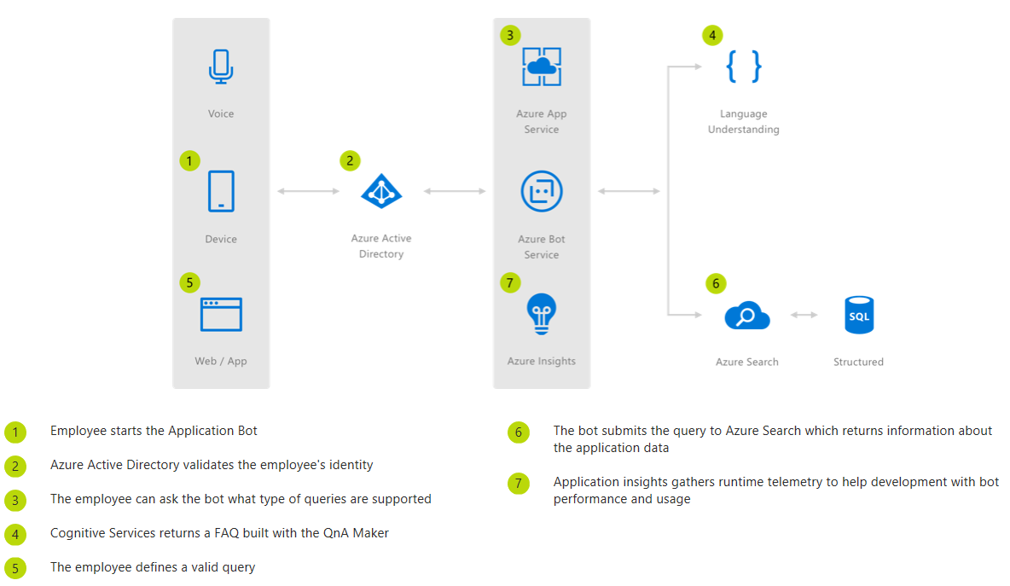

Informational Chatbot
This Informational Bot can answer questions defined in a knowledge set or FAQ using Cognitive Services QnA Maker and answer more open-ended questions using Azure Search.
"Conversation as a platform is the future, so it's great that we're already offering it to our customers using the Bot Framework and Azure."
Katie Duffy, Application Architect at UPS

Slide 18
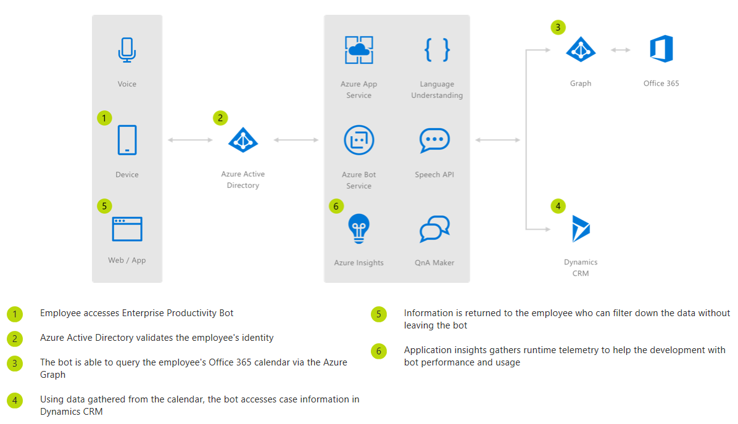
Enterprise Chatbot
“ Azure Bot Service can be easily combined with Language Understanding to build powerful enterprise productivity bots, allowing organizations to streamline common work activities by integrating external systems, such as Office 365 calendar, customer cases stored in Dynamics CRM and much more. “

Slide 19
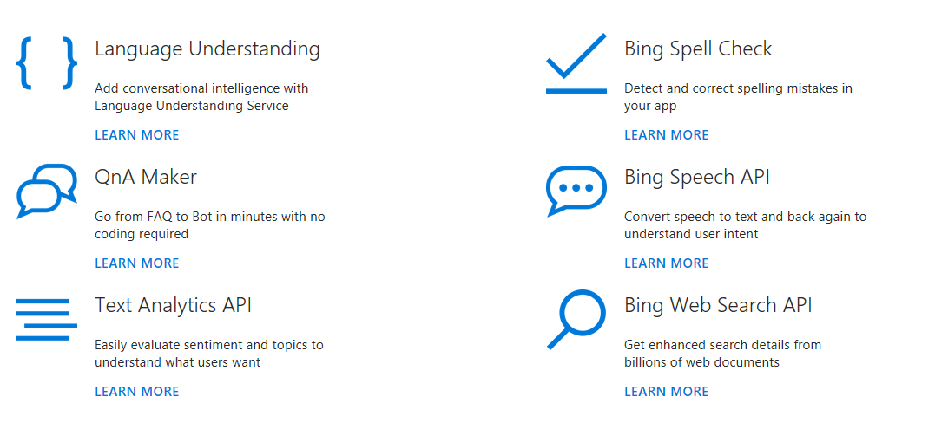
Building Intelligent Bots
Check out our comprehensive conversational AI framework for the development life cycle of your bot to create a simple bot and add sophisticated capabilities, such as speech, language understanding, QnA and more.

Slide 20
Summary
Summary
Digital Transformation does not occur in a silo
Become a change agent within your organization
Regardless of your persona!
Leverage cost-effective Microsoft platform services to drive innovation
On a consumption basis
If it doesn’t work, throw it away
The future is not as far away as you think
Look for where the puck is headed, not where it currently is

